Slide 1
Holocene multidecadal and multicentennial droughts affecting Northern California and Nevada
Larry Benson, Michaele Kashgarian, Robert Rye, Steve Lund, Fred Paillet, Joseph Smoot, Cynthia Kester, Scott Mensing, Dave Meko, Susan Lindström
Presentation by: Kelly Hughes
Assistance from: Matt Poole
13NOV2012

Slide 2
Holocene: Tripartite Structure
Historical Period
100 yr
11,600 ka
8,000 ka
3,000 ka
present

Slide 3
Drought
Middle Holocene ~
Times when Lake Tahoe didn’t overflow
Late Holocene ~
Times of persistent lake size decline
Historical Period ~
Water shortage affected humans adversely

Slide 4
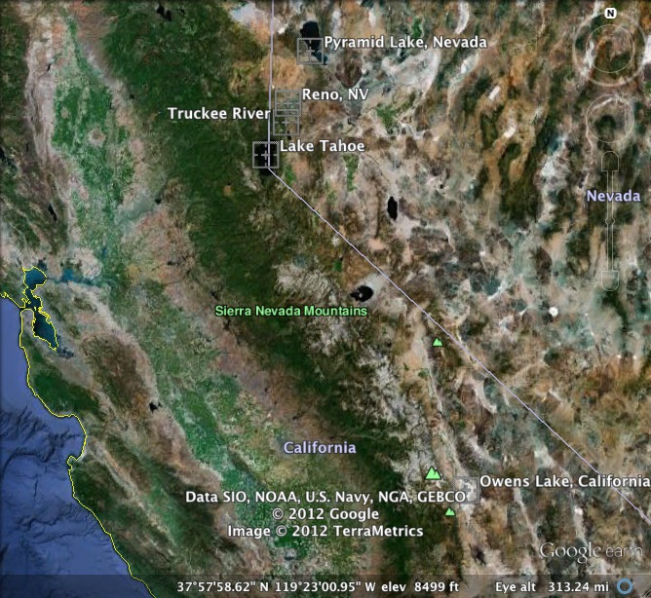
Study Areas of the Great Basin

Slide 5
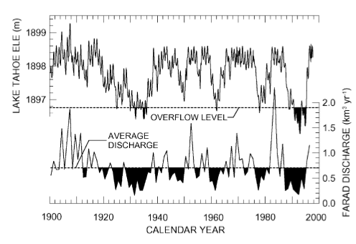
Hydrologic balance of the last 100 yrs
Dust Bowl of ‘30s
7 yrs of drought from late ‘80s to early ‘90s
Fig. 1. Annual discharge of the Truckee River at Farad, California, and monthly elevation of Lake Tahoe at Tahoe City, California, since 1900. Only minor consumptive losses of Truckee River water occur upstream of the Farad gage (Fig. 5). Solid areas in top panel indicate times that Lake Tahoe did not overflow to the Truckee River. Solid areas in lower panel indicate times when flow of the Truckee was less than the historical mean-annual rate of 0.70 km³ yr⁻¹. Note that most minima in lake level correspond to minima in discharge rates.

Slide 6
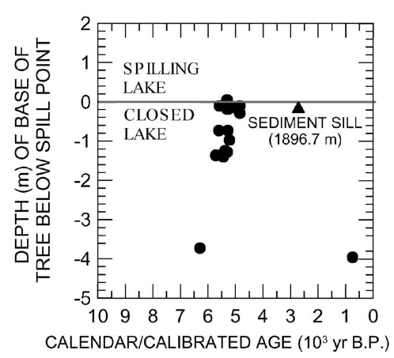
Tree stumps
Harding (1965)
0.09 m below sill
4250 – 4790 ¹⁴C yr BP
Lindström (1990)
4 m below sill
4240 – 5510 ¹⁴C yr BP
Fig.2. Age–depth relationships of radiocarbon-dated tree stumps located at or below the natural (sediment) sill level of Lake Tahoe, California. Most of the data were taken from Lindström (1990). Three samples from Baldwin Beach(4250±200 ¹⁴C yr BP, 1896.41 m, Beta 56632), and Trout Creek delta (4480±60 ¹⁴C yr BP, 1895.82 m, Beta 90208; 4590±60 ¹⁴C yr BP, 1895.52 m, Beta 90207) were previously unpublished. Note that the death of a stump as indicated by the ¹⁴C age of its outer rings pinpoints the timing of a rise in Lake Tahoe; e.g., a rising lake at ~6290 cal yr BP killed the oldest stump.

Slide 7
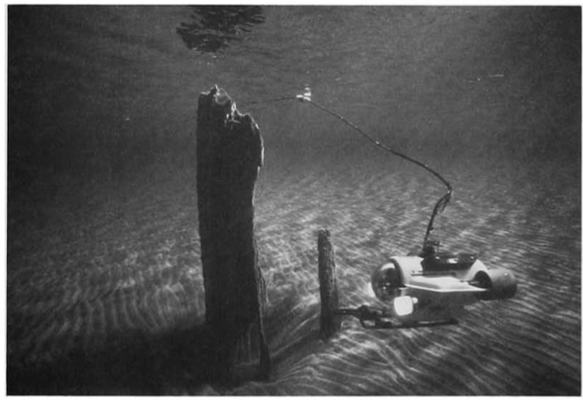
LindstrÖM (1990)
Lake Tahoe
Avg depth = 1000 ft (8th deepest in the world)
100 input streams
Single output =
Truckee River
Emory Kristof, © National Geographic Society
Notes:
At an average surface elevation of 6,225 feet, and with an area of 191 square miles, Lake Tahoe is the highest lake of its size in the United States. It is 22 miles long, 12 miles wide, and holds 122 million acre feet of water, enough to cover a plane the size of the state of California to a depth of 14 inches.The lake is the third deepest in North America and the eighth deepest in the world, with a maximum depth of 1,645 feet and an average depth of 1,000 feet. It is fed by about 100 streams, and the Truckee River is its only outlet. The level of Lake Tahoe is naturally controlled by a narrow sill at Tahoe City; a sill is the lowest point on a divide separating adjoining sub-basins (Lindstrom, 1990).

Slide 8
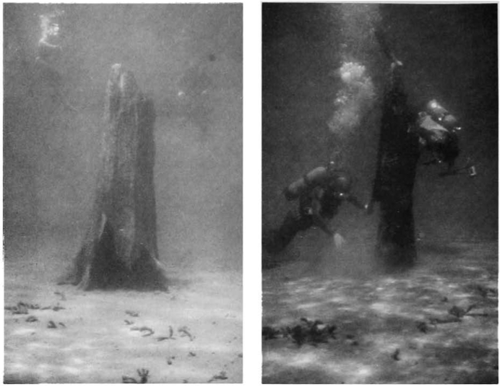
Lindström (1990)

Slide 9
Other indicators of warm, arid climate during middle holocene in great basin
Lowered sedimentation rates in NV marshes
Decreased species richness
Well-dated small mammal fauna
Absent black mats in south Great Basin
Sediment hiatus in Owens Lake
High tree-line elevations
Disappearance of pikas from low elevations
Warm summer species of plants more common
Scarce archaeological textiles
Owens Lake TIC oscillations and desiccation

Slide 10
Grayson (1993, 2000)
Fig. 4. Histogram of dates on archaeological textiles from the western Great Basin (from data base compiled by Susan McCabe and Eugene Hattori). Multiple dates on samples from a single time horizon have been eliminated.

Slide 11
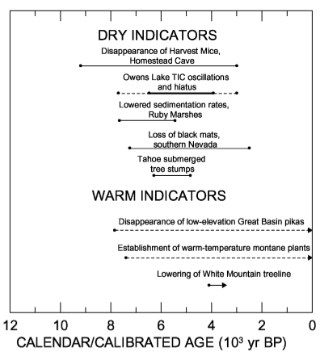
Warm, dry climate summary
Climate change may not have occurred synchronously across Great Basin
Each indicator is imperfect, possessing its own response to climate variability

Slide 12
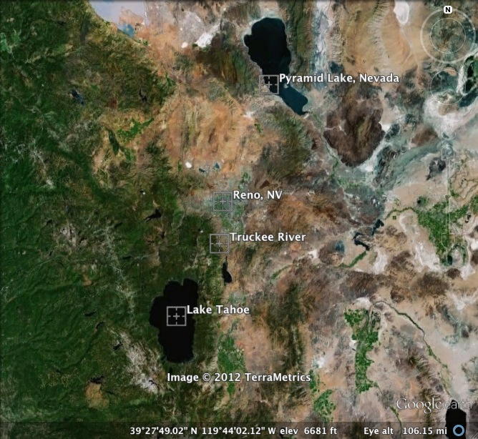
Truckee river – pyramid lake system

Slide 13
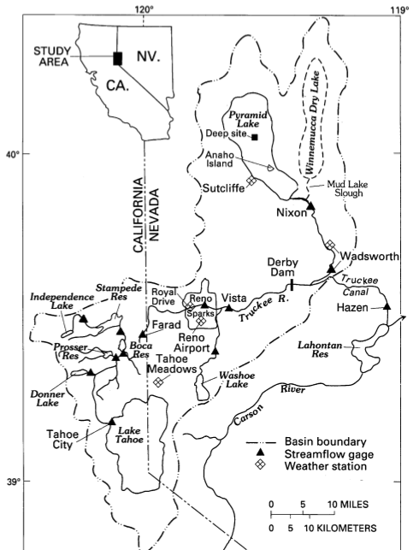
Truckee river – pyramid lake system
Notes:
Point out Pyramid, Truckee and Tahoe first. Then:
Derby Dam, & how it diverts 54% of Truckee River discharge to the canal and Lahonton Res.
Farad gauge upstream of Fresno
Nixon gauge just upstream of the sill that when surpassed, water spills out into Winnemucca.

Slide 14
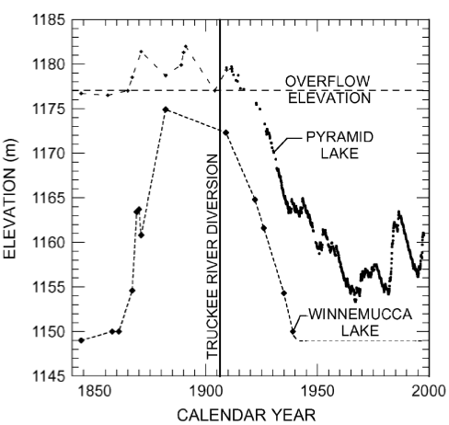
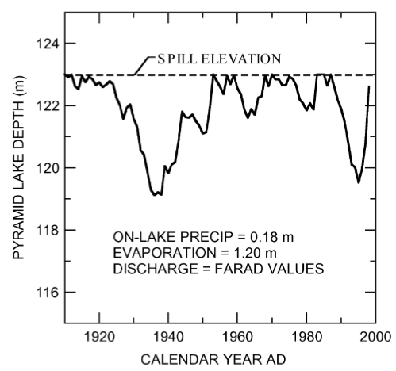
Why pyramid lake?
Part of relatively simple hydrologic system
Closed system
Input = Truckee River + precipitation
Output = evaporation
Notes:
Top R fig: Elevation of Pyramid and Winnemucca lakes since 1844. Diversions from the Truckee River began about 1860 and were accelerated after the completion of the Derby Dam and Truckee Canal in 1906. As a result of the diversions, Winnemucca Lake, which frequently received spill from Pyramid Lake, desiccated in B1938. Pyramid has not overflowed since 1917.
Bottom L fig: Reconstruction of the pristine elevation of Pyramid Lake since 1910. Annual values of Truckee River discharge for the Farad, California, gage (Fig. 5), together with an evaporation rate of 1.20 m and on-lake precipitation rate of 0.18 m, were used in the reconstruction.

Slide 15
Why pyramid lake, continued
Change in hydrologic balance is transferable to rivers that drain both flanks of the northern Sierra Nevada
Yuba correlates to Truckee, etc
More south, however, correlation weakens
Notes:
Fig. 8. Surface drainage of streams emanating from the Sierra Nevada, California and Nevada. Streams flowing east terminate in Great Basin lakes and sinks; streams flowing west become part of either the Sacramento or San Joaquin River systems which terminate in San Francisco Bay, California. The crest of the Sierra Nevada is shown as a dashed–dotted line. In the spring and early summer, winter snows, which accumulate along the Sierran crest, melt, feeding rivers located on both flanks of the Sierras.

Slide 16
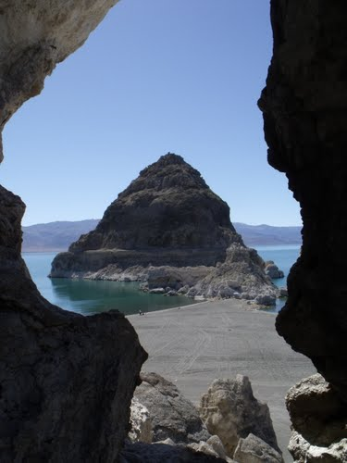
Why Pyramid lake, continued
Deepest lake in Great Basin and sediments accumulate rapidly
Less susceptible to desiccation and deflation
Resolve hydrologic balance changes at sub-decadal scale
Nature's Window by briantravelman
Notes:
Average of 109 m deep, max 123 m deep before ____.

Slide 17
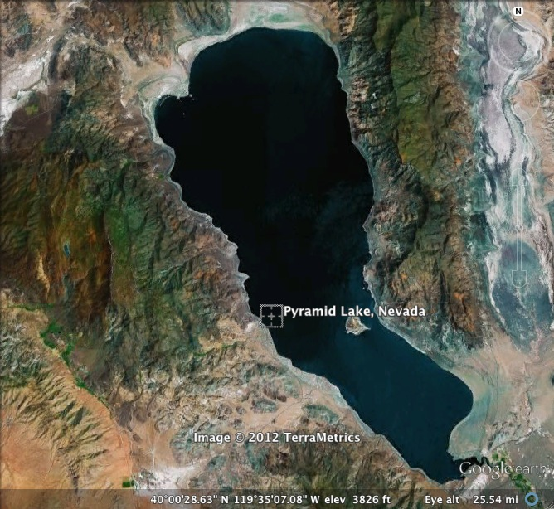
Coring of Pyramid Lake
LAKE RANGE
PLC97-1
PLB98-2
PLC98-4
VIRGINIA MOUNTAINS
Notes:
Fig. 10. Coring sites, Pyramid Lake, Nevada. Water depths are >100 m at the sites of the piston and box cores (PLC97-1, PLC98-4, PLB98-2). Dotted line represents PLS samples taken along a transect starting in the deep basin of Pyramid Lake and ending at Pelican Point. PLS samples are samples taken right at the water-sediment interface (surface sediments). The inner dashed line indicates the area that Pyramid Lake achieved during overflow to the Winnemucca Lake basin.

Slide 18
Age control by ¹³⁷Cesium, mercury, and Paleomagnetic secular variation
Matt Poole

Slide 19
Methods
Sampling interval: every 1 cm (0.5 cm for top of PLB98-2)
Sample integration on order of 5 to 10 yr
Sample prep
δ¹³C and δ¹⁸O – MS
TIC and TC – CO₂ coulometer
TOC by difference
X-ray diffraction
Hg – cold-vapor atomic fluorescence spectrometry
¹⁴C – contracted out to CAMS
Magnetic susceptibility
Long-core: every 2 cm on day of collection
NRM and magnetic susceptibilities measured on sample cubes every 2.5 cm for PLC97-1
Notes:
CAMS = Center for Applied Mass Spectrometry at Lawrence Liverpool National Laboratory
NRM = natural remanent magnetizations
There are several kinds of NRM that can occur in a sample. Many samples have more than one kind superimposed. Thermoremanent magnetization (TRM) is acquired during cooling through the Curie temperature of the magnetic minerals and is the best source of information on the past Earth's field. Magnetization formed by phase change, chemical action or growth of crystals at low temperature is called chemical remanent magnetization. Sediments acquire a depositional remanent magnetization during their formation or a post-depositional remanent magnetization afterwards.[1]Some kinds of remanence are undesirable and must be removed before the useful remanence is measured. One is isothermal remanent magnetization (IRM), which as a component of NRM generally means remanence induced by lightning strikes. Another is viscous remanent magnetization (VRM), a remanence acquired when the rock sits in the Earth's field for long periods.[1]The most important component of remanence is that acquired when a rock formed. This is called its primary component or characteristic remanent magnetization (ChRM). Any later component is called a secondary component. To separate these components, the NRM is stripped away in a stepwise manner using thermal or alternating field demagnetization techniques to reveal the stable magnetic component.[1]

Slide 20
Delta-¹⁸O as a hydrologic indicator

Slide 21
Delta-¹⁸O as a hydrologic indicator
Hydrologic & isotopic steady states (SS) are never fully achieved
Wet periods: input of “light” river water > loss of “light” evaporated water
As volume of closed basin ⬆, δ¹⁸O_{lake} ⬇
Dry periods: loss of “light” evaporated water > input of “light” river water
As volume of lake ⬇, δ¹⁸O_{lake} ⬆

Slide 22
Delta-¹⁸O as a hydrologic indicator
A simple constant relationship between lake volume and δ¹⁸O_{lake} does not exist
δ¹⁸O_{lake} for overflowing lake is proportional to V_{spill}/V_{lake}
4 processes keep δ¹⁸O_{lake} from being an effective indicator of the absolute intensities of dry and wet periods, but it does record the duration of a climate oscillation
Overflow: part of discharge flows directly to Winnemucca, not mixing w/ epilimnion of lake
Natural driftwood dams, diverting flow
Sediment focusing from shallow-water to deep-water
Bioturbation smoothes δ¹⁸O_{lake} record

Slide 23
TIC as a hydrologic indicator
Fuzzy indicator of lake-size change
Indicates transitions from closed to open systems
Useful for assessing abrupt changes to hydrologic balance
Dissolved Ca²⁺ precips as Aragonite (CaCO₃)
Ca²⁺ is linear function of discharge
Siliciclastic material (suspended load) is exponential function of discharge
Thus, TIC fraction ⬇w/ ⬆discharge (lake volume)
But, persistent drought (⬇ in lake size) can lead to reworking and messes up this relationship; hence its use for rapid changes only

Slide 24
Magnetic susceptibility
Magnetic susceptibility of surface sediments ⬇ linearly with depth in lake (fig 18)
Magnetite, denser than avg sediment, is retained in shallow water
⬇ lake size, distance between shore & deep basin ⬇
Greater proportion of magnetite-rich seds reach deep basin

Slide 25
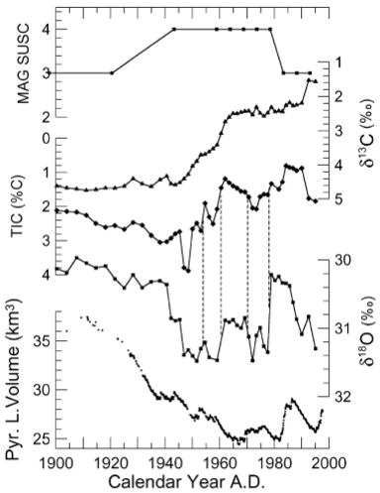
Fig. 25. Magnetic susceptibility, δ¹³C, TIC, and δ¹⁸O records from PLB98-2 plotted against Pyramid Lake volume since 1900. Dashed lines connect nearly simultaneous excursions in the TIC and δ¹⁸O records associated with abrupt changes in the size of Pyramid Lake.

Slide 26
Model simulation of pyramid lake
Stable-isotope hydrologic-balance model
Variable inputs:
Initial depth & δ¹⁸O_{lake}
Annual TR discharges
Annual precipitation on lake
Annual rates of evaporation
TR δ¹⁸O_{in} value:
δ¹⁸O of snowmelt
δ¹⁸O of Lake Tahoe

Slide 27
Model simulation of pyramid lake
Fixed inputs for calculation of fractionation during evap:
Monthly relative humidities
Monthly air & water temps
Monthly δ¹⁸O and fraction of advected air in the boundary layer above the lake
Measured wind speeds were used to set isotopic kinetic fractionation factor

Slide 28
Model simulation of pyramid lake
Lake Tahoe
Allowed to spill - discharge δ¹⁸O calculated by combining:
1 part Lake Tahoe water (δ¹⁸O = –5.5m)
2 parts snowmelt runoff (δ¹⁸O = –14.5m)
Not allowed to spill (ceased overflowing) – discharge δ¹⁸O was assigned pure snowmelt runoff value

Slide 29
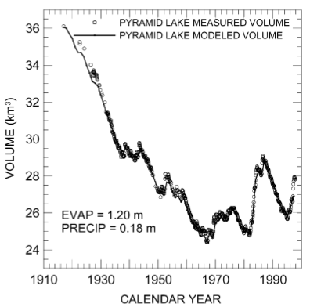
Model compared to measured volume
Model captures all measured changes in lake volume
Using:
Mean-annual historic discharges from Nixon gage
Mean evap and precip rates

Slide 30
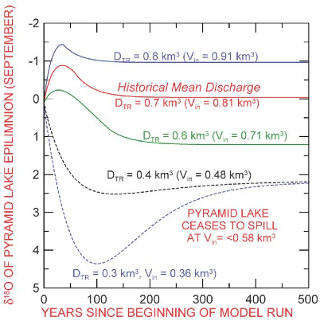
Variable discharge
Simulated δ¹⁸O values as a function of variable Truckee River discharge (D_{TR})
⬆discharge & overflow to Winnemucca = ⬇ δ¹⁸O SS values
Smaller discharge = greater transient response amplitude
Closed system = same SS δ¹⁸O value of 2.2 permil no matter V_{in}

Slide 31
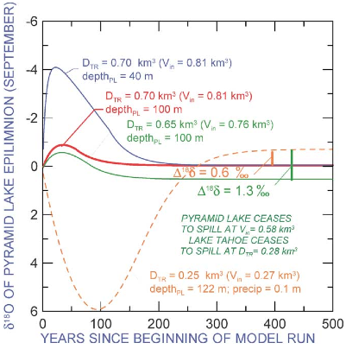
Modeled response to severe drought
Simulated responses to onset and recovery from severe drought
Severe drought = hydrologic closure of both Lake Tahoe & Pyramid Lake
Loss of isotopically heavy Lake Tahoe input = ⬇δ¹⁸O during severe & prolonged drought
⬆wetness after severe drought = initial (-) transient response & same SS δ¹⁸O as for mean-historical discharge (red)

Slide 32
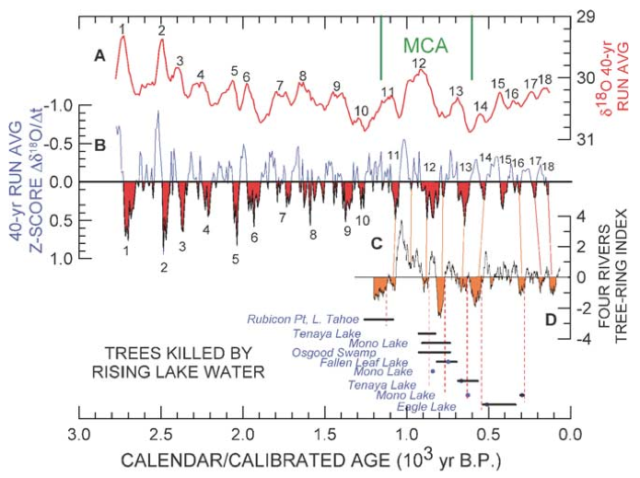

Slide 33
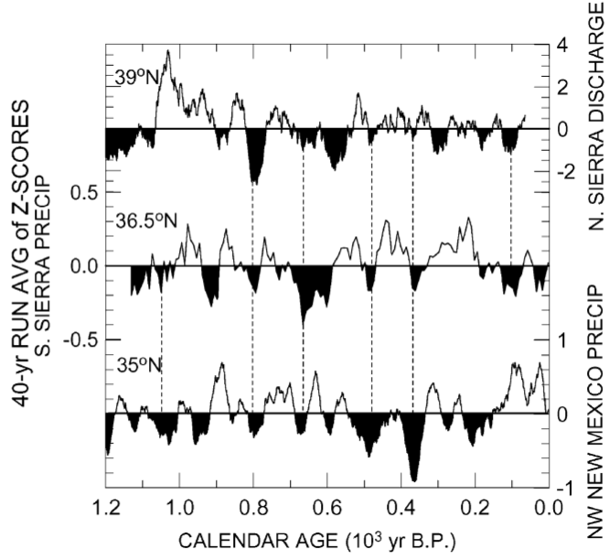
Regional comparison of droughts

Slide 34
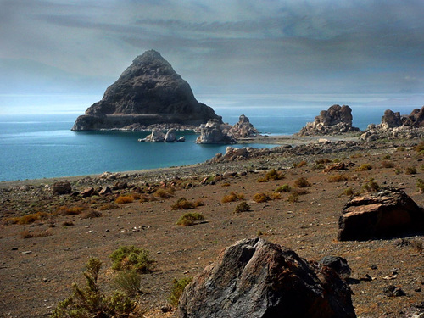
Lessons from pyramid lake
⬇mag sus + ⬆TIC reflect ⬆ lake depth @ 6.7 ka
From 7.6 – 6.5 ka: highly fluctuating mag sus & δ¹⁸O = shallow lake + large/abrupt hydrologic-balance changes
Shift to more positive δ¹⁸O values reflect colder wetter climate beginning 3.1 ka
Stable-isotope hydrologic-balance model suggests Lake Tahoe didn’t overflow during much of the middle Holocene
Implying that runoff to Lake Tahoe ⬇by 30%
Oscillations in δ¹⁸O exist through middle-Holocene
On average every 150 yr
Reflect multidecadal droughts as frequent as every 80 yrs
Human-induced diversion of Truckee River will cause Pyramid Lake to reach new SS depth of only 64 m
Human-imposed drought will have greater impact on size of Pyramid Lake than some of droughts of the past 2000 yrs

Slide 35
References
Lindström, S., 1990. Submerged tree stumps as indicators of Mid-Holocene aridity in the Lake Tahoe basin. Journal of California and Great Basin Anthropology 12, 146–157.
Google Earth imagery, 2012.
Benson, L. et al., 2002. Holocene multidecadal and multicentennial droughts affecting Northern California and Nevada. Quaternary Science Reviews. 21, 659-682.

